Slide 1
Steam Turbines

Slide 2
A steam turbine is a prime mover which continuously converts the energy of highpressure, high temperature steam supplied by a steam generator into shaft work with the low temperature steam exhausted to a condenser.
This energy conversion essentially occurs in two steps:
1. The high-pressure, high-temperature steam first expands in nozzles and comes out at a high velocity.
2. The high velocity jets of steam coming out of the nozzles, impinge on the blades mounted on a wheel, get defl ected by an angle and suffer a loss of momentum which is absorbed by the rotating wheel in producing torque.

Slide 3
A steam turbine is basically an assemblage of nozzles and blades.
The Greek inventor Hero of Alexandria built the first prototype of a steam turbine in 120 BC which operated on the reaction principles.
A simple closed spherical vessel, mounted on bearings, carrying steam from a cauldron or boiler with four tangential pipes discharging steam is driven around by the reaction of the steam jets (Fig. 7.1 a).
Many centuries later, Giovanni Branca made the prototype of the impulse steam turbine in 1629, which is often referred to as the Branca’s wheel.

Slide 4
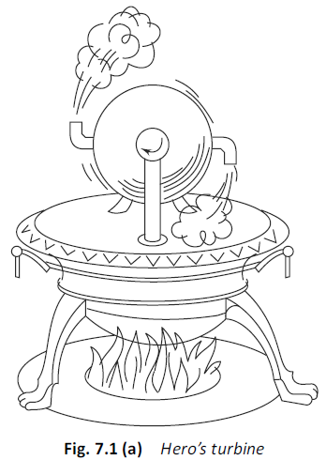

Slide 5
Steam turbines are not only employed to operate electric generators in thermal and nuclear power plants to produce electricity, but they are also used
(a) to propel large ships, ocean liners, submarines and so on, and
(b) to drive power absorbing machines like large compressors, blowers, fans and pumps.

Slide 6
FLOW THROUGH NOZZLES
A nozzle is a duct by flowing through which the velocity of a fluid increases at the expense of pressure drop.
A duct which decreases the velocity of a fluid and causes a corresponding increase in pressure is called a diffuser.
The same duct may be either a nozzle or a diffuser depending upon the end conditions across it.
If the cross-section of a duct decreases continuously from inlet to exit, the duct is said to be convergent, and if it increases from inlet to exit, the duct is said to be divergent.

Slide 7
If the cross section initially decreases and then increases, the duct is called convergent-divergent.
The minimum cross section of this duct is referred to as throat
.
A fluid is said to be compressible if its density changes with a change in pressure (or temperature).
If the density does not changes or changes very little, the fluid is said to be incompressible.
Gases and vapours are compressible, whereas liquids are incompressible.

Slide 8
Nozzle Efficiency
Due to friction between the fluid and walls of the nozzle, the expansion process is irreversible, although still approximately adiabatic.
In nozzle design, the usual practice is to base all calculations on isentropic flow and then to make an allowance for friction using a coefficient or efficiency.
The nozzle efficiency, ηn, is defined as the ratio of the actual enthalpy drop to the isentropic enthalpy drop (Fig. 7.8),

Slide 9
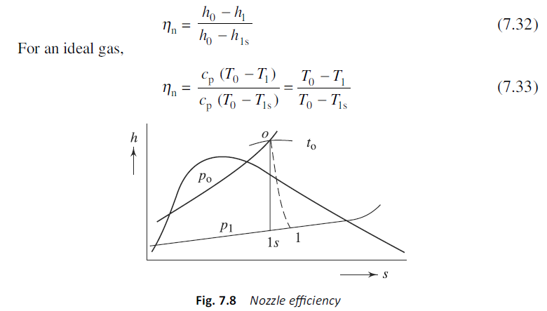

Slide 10
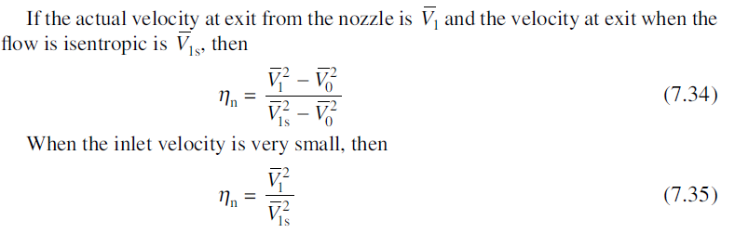
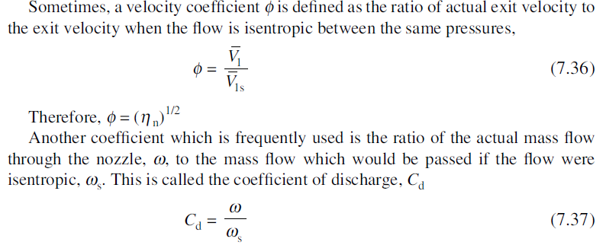

Slide 11
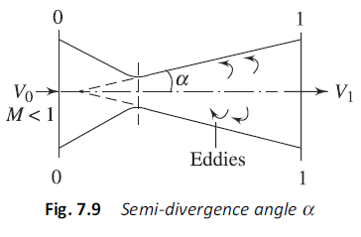
The convergent part of a nozzle is usually sharp, while the divergent part is gradual.
Most of the friction loss occurs in the divergent portion of the nozzle.
If the semi-divergence angle a is large (Fig. 7.9), there will be flow separation from the wall with the formation of eddies, which entails energy loss.
If the angle a is small, the length of nozzle becomes large to provide the desired exit flow area, causing more energy loss due to friction.
Usually, α varies from 5° to 8°.

Slide 12
Nozzle Types
Probably the most common physical conception of the nozzle is the converging diverging type, although its application in the turbine design is somewhat limited.
More generally, the converging or subsonic nozzles are used.
There are two types of nozzles:
1. Reamed or round nozzles
2. Foil nozzles
Reamed nozzles are used principally in the high pressure impulse stages of
steam turbines.
The principal advantages of the reamed nozzle are low cost, ease of manufacture, and adaptability to standardization.
The principal disadvantages are lower efficiency, somewhat greater length, and an inability to utilize effectively for flow purposes the area of a given flow annulus.

Slide 13
The angle of divergence in reamed nozzles, as mentioned earlier, is usually about 12° and rarely over 15°, in order to avoid flow separation with its attendant loss.
The converging part is normally sharp and a good fillet or rounded entrance is provided.
The foil nozzle is formed by curved airfoil sections.
The nozzle is short with well-rounded entrance edges and sharp exit edges affording a good issuing jet.
These nozzles have high efficiency and are costlier. A foil nozzle block is made by welding the individual foils between sections of concentric rings.
The block is then welded in place between the outer and inner shrouds. The foil nozzle finds wide application in large steam turbines.

Slide 14

Flow Area of Nozzle
If the condition of steam at inlet to the nozzle is known, the critical pressure p* can be estimated by multiplying the inlet pressure p0 by 0.546 or 0.577 depending on whether the inlet steam is superheated or dry saturated, respectively.
If the exit pressure is given and the nozzle efficiency is known, the exit velocity of steam, as well as the critical velocity of steam at the throat can be estimated from

Slide 15
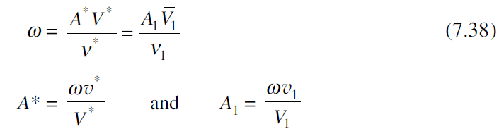
where the enthalpy drops are read from the Mollier chart (kJ/kg).
With the actual states of steam at exit and the throat being fixed on the Mollier diagram, the specific volumes can be obtained from it.
Knowing the mass flow rate of steam (w), the flow areas required at the nozzle exit, as well as at the throat can be estimated from

Slide 16

If the nozzles are circular in cross section,
where n is the number of nozzles and dexit is the exit diameter of the nozzles.
The cross section may be rectangular or square also.
Foil-type nozzles are mounted in a nozzle diaphragm which is horizontally split into two halves and joined by vertical flange bolts (Fig. 7.10a).
The top halves of the diaphragms, which form the stator, can be lifted by cranes thus exposing the rotor for inspection and repair, if needed.

Slide 17
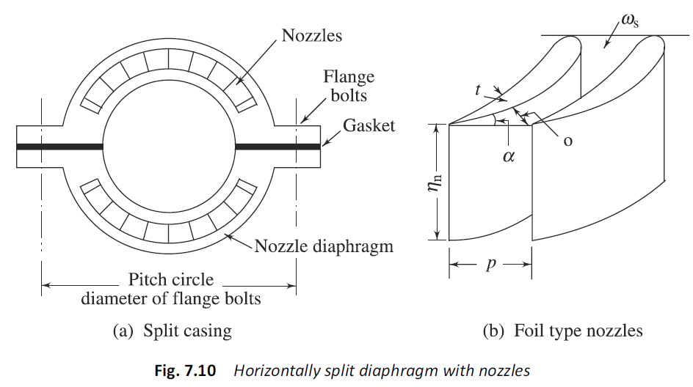

Slide 18
Steam is expanded in a set of nozzles from 10 bar. 300 °C to 2 bar. Are the nozzles convergent or convergent–divergent? Neglecting the initial velocity, find the minimum area of the nozzles to flow 1 kg/s of steam. Assume isentropic expansion.

Slide 19
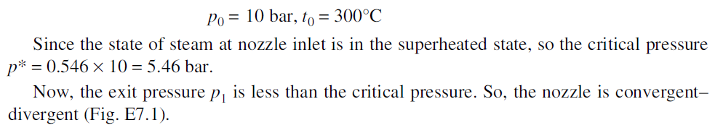
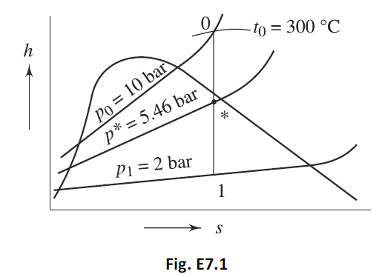

Slide 20
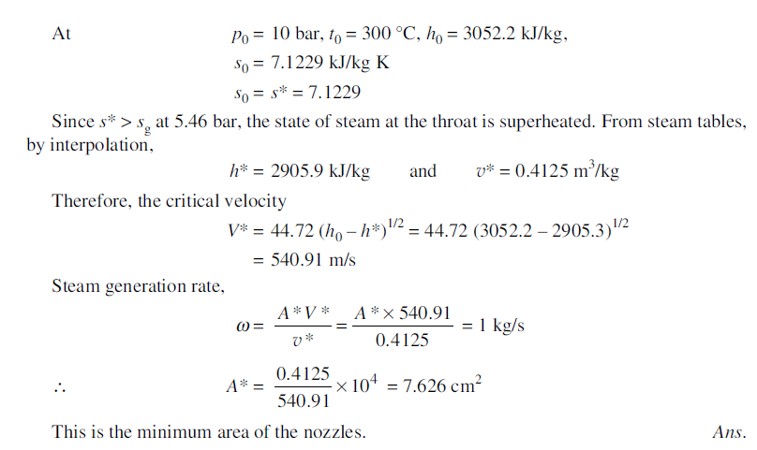

Slide 21
TURBINE BLADING
Depending upon the types of blades used and the method of energy transfer from the fluid to the rotor wheel, the turbines may be of two types:
(a) Impulse turbines
(b) Reaction turbines
Impulse Turbines
In impulse turbines, all pressure drops of steam occur in the nozzles
and there is no pressure drop as steam flows through the passage between two blades.

Slide 22
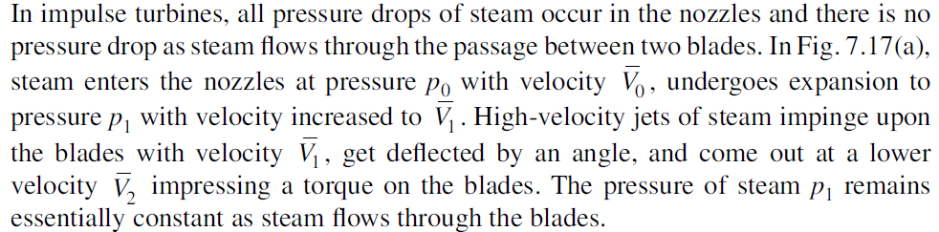

Slide 23
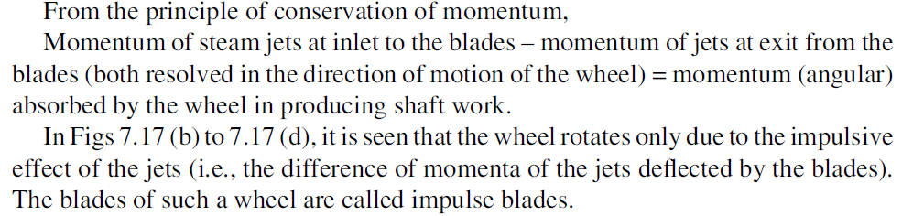

Slide 24
High-velocity jets of steam impinge upon the blades with velocity 1 V , get deflected by an angle, and come out at a lower velocity 2 V impressing a torque on the blades. The pressure of steam p1 remains essentially constant as steam flows through the blades.
From the principle of conservation of momentum,
Momentum of steam jets at inlet to the blades – momentum of jets at exit from the blades (both resolved in the direction of motion of the wheel) = momentum (angular) absorbed by the wheel in producing shaft work.
In Figs 7.17 (b) to 7.17 (d), it is seen that the wheel rotates only due to the impulsive effect of the jets (i.e., the difference of momenta of the jets deflected by the blades).
The blades of such a wheel are called impulse blades.

Slide 25
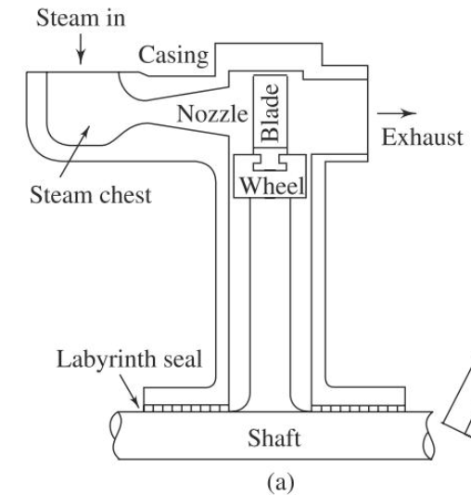



Slide 26
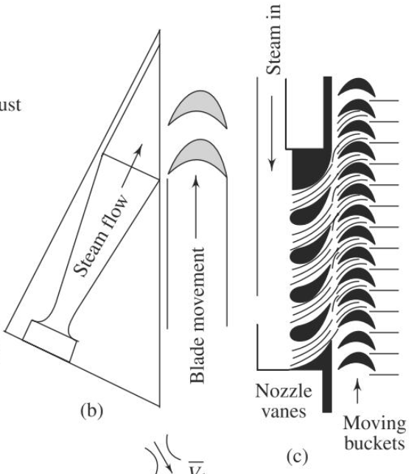

Slide 27
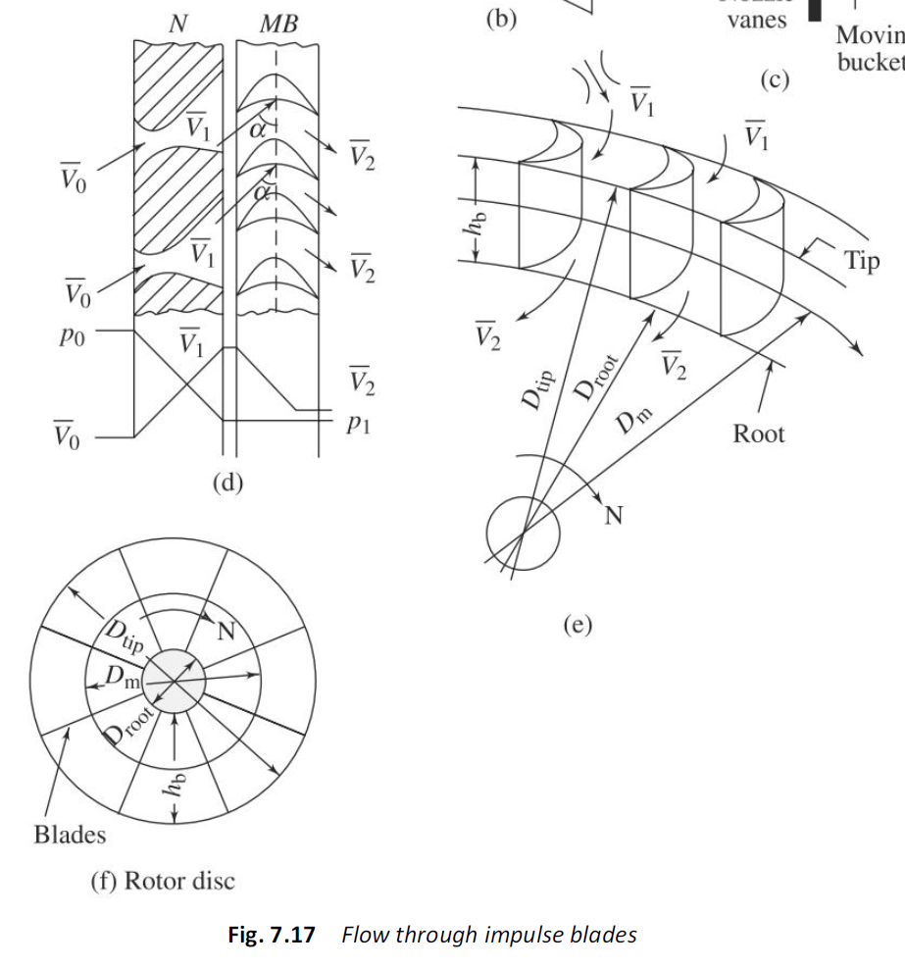

Slide 28
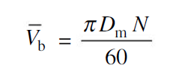

The mean peripheral velocity of the blades, also called the mean blade velocity, Vb-bar , is given by
where Dm is the mean diameter of the wheel and N is its rpm. The area of flow or blade annulus (Fig. 7.17(e)), Ab, is given to be
where D1 is the root diameter, D2 is the tip diameter, and hb is the height of the blades.

Slide 29



Velocity Diagrams, Diagram Work and Diagram Efficiency
Steam coming out from the nozzles at absolute velocity strikes the blades with relative velocity while the blades rotate with mean peripheral velocity . .
Steam leaves the blades with relative velocity while its absolute velocity is .
As shown in Fig. 7.18(a), α is the nozzle angle subtended by the nozzle axis with the direction of rotation of the wheel, β1 is the inlet blade angle and β2 is the exit blade angle.
The inlet and exit velocity triangles of Fig. 7.18(a) have been superposed on a common in Fig. 7.18(b).
If all the angles are measured clockwise, then γ is the exit blade angle (γ = 180 – β2) and δ is the angle made by absolute exit velocity of steam leaving the blades with the plane of rotation of the wheel.

Slide 30
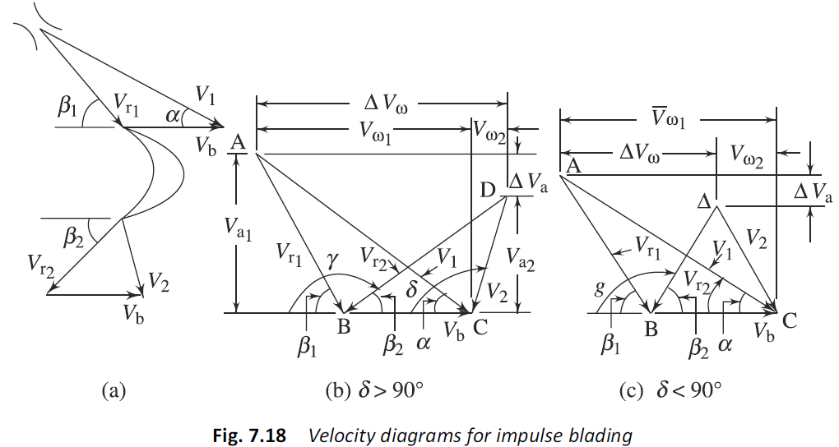

Slide 31

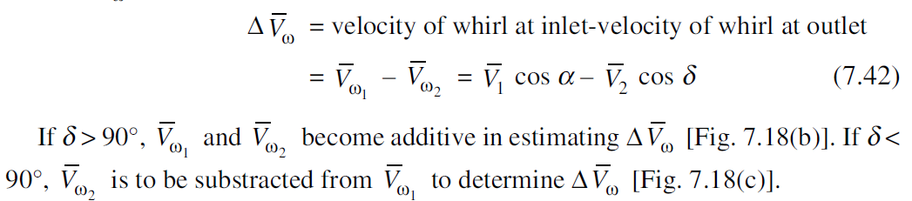
It is the difference of the cosine components of the velocities of steam which drives the wheel and produces the torque.
It is called the change in the velocity of whirl, , which is given by

Slide 32
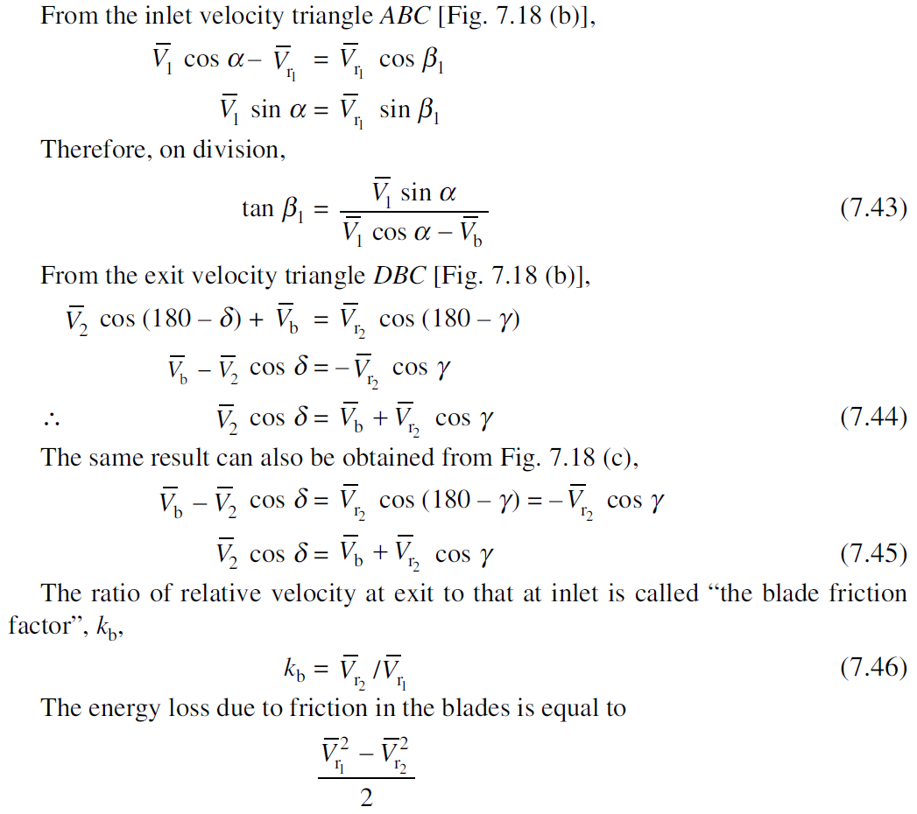

Slide 33
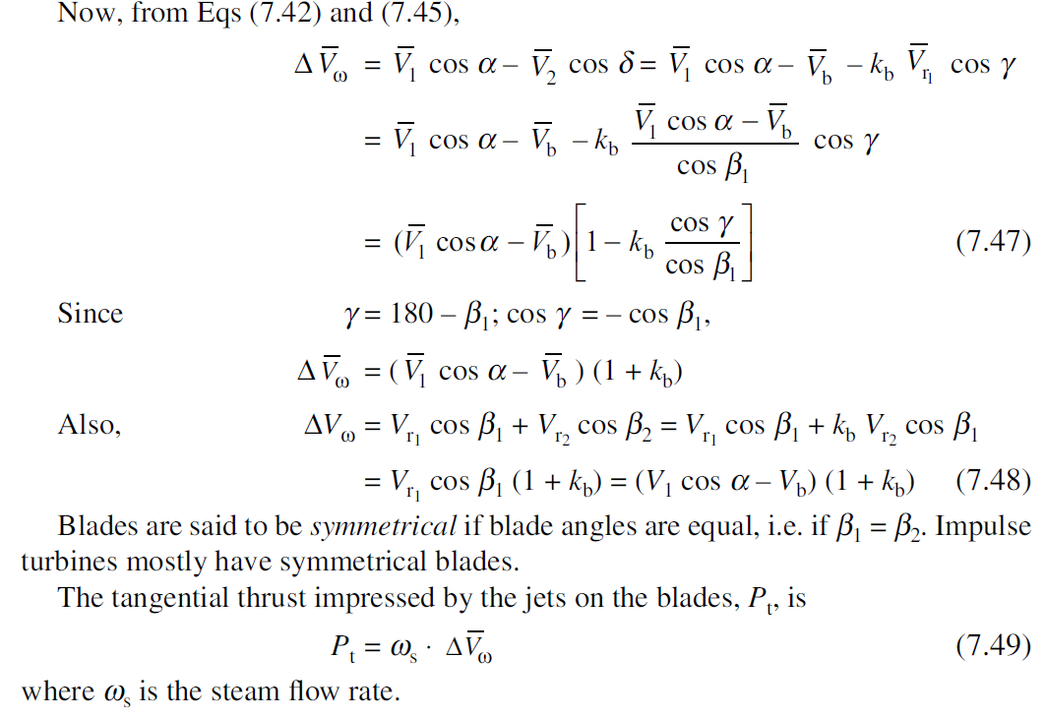

Slide 34
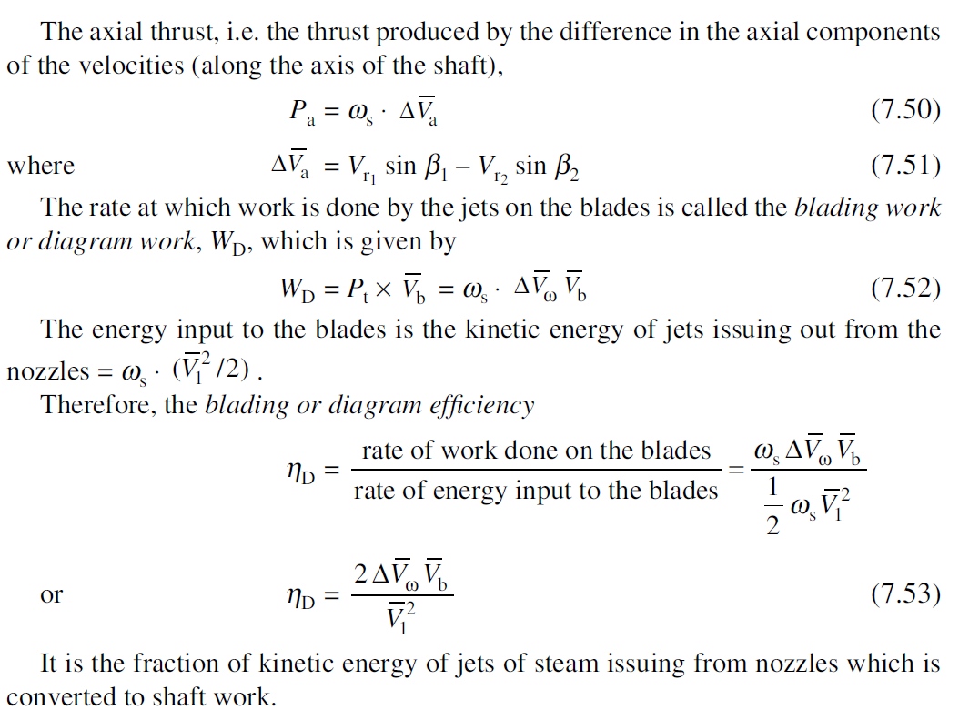

Slide 35
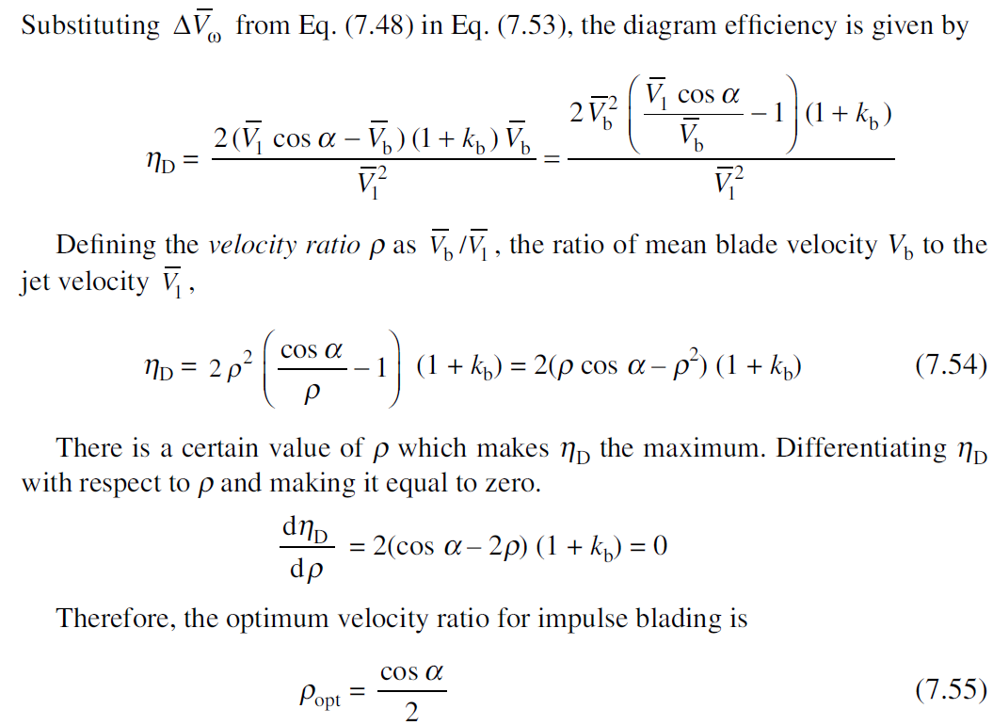
Optimum Velocity Ratio

Slide 36
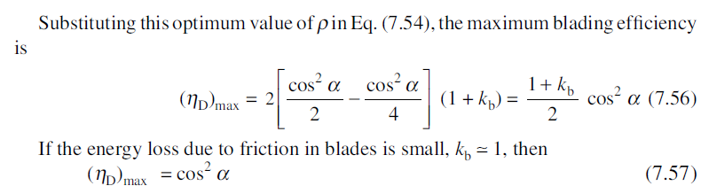
where α is the nozzle angle.
The lower is the nozzle angle, higher is the blading efficiency.
However, too low a nozzle angle may cause energy loss at blade inlet.
Therefore, the nozzle angle has to be maintained within a certain range, which varies from 16° to 22°.

Slide 37
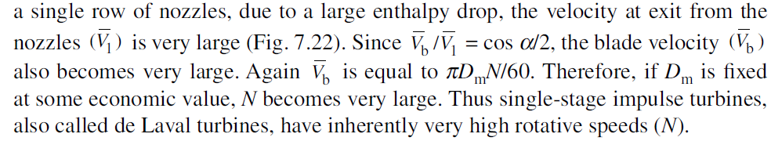
Compounding of Steam Turbines

Slide 38
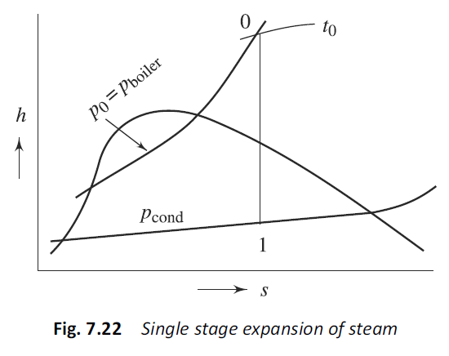

Slide 39
Such high rotational speeds cannot be properly utilized.
It entails large friction losses.
The centrifugal stresses also become very large.
Alternatively, if N is fixed, the diameter of the wheel becomes too large.
Moreover, with a single stage, the velocity of steam at exit is sufficiently high and there is a considerable loss of kinetic energy with exiting steam.
To obviate these difficulties the turbines are compounded or staged, where steam instead of expanding in a single stage is made to expand in a number of stages, whereby the turbine speed is reduced while securing the same enthalpy drop of steam.
Basically, there are two ways of compounding steam turbines:
1. Pressure compounding or Rateau staging
2. Velocity compounding or Curtis staging

Slide 40
Pressure Compounding or Rateau Staging
The pressure compounding or Rateau staging corresponds to putting a number of simple impulse stages in series (Fig. 7.23).
The total enthalpy drop is divided equally among the stages (Fig. 7.24).
The pressure drops only in the nozzles.
There is no pressure drop (theoretically) while steam flows through the blades.
The kinetic energy of steam increases in the nozzles at the expense of the pressure drop and it is absorbed (partially) by the blades in each stage, in producing torque

Slide 41
In Fig. 7.24, the total isentropic enthalpy drop of steam (h0 – h4) is divided equally among the four stages of the turbine.
In Mollier diagram, the enthalpy drop (h0 – h4) is measured, then the enthalpy drop, h0 – h1 = h1 – h2 = h2 – h3 = h3 – h4 = (h0 – h4)/4 are computed and inserted on the insentropic line.
The interstage pressures noted from the diagram are p1, p2 and p3, i.e. the pressure after first stage is p1, the pressure after second stage is p2, and so on.

Slide 42
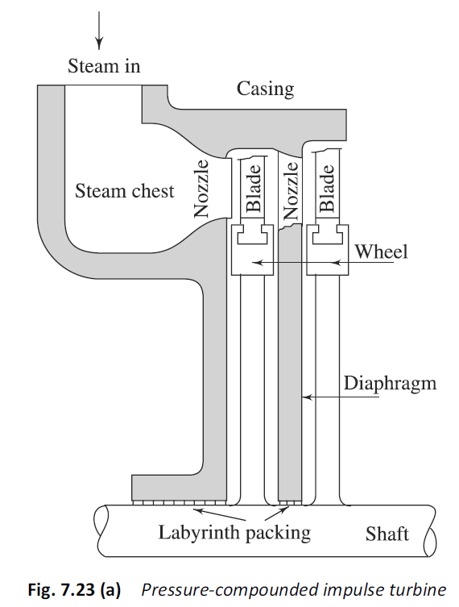

Slide 43
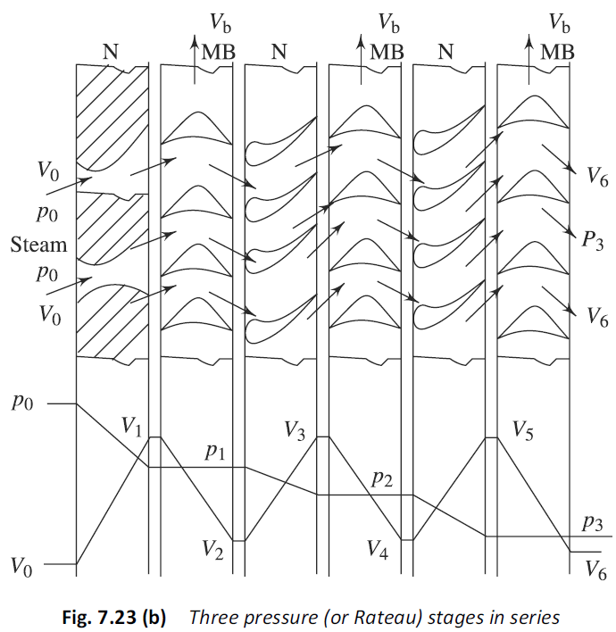

Slide 44
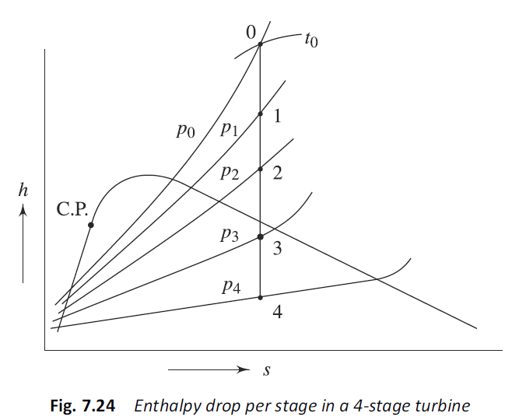

Slide 45
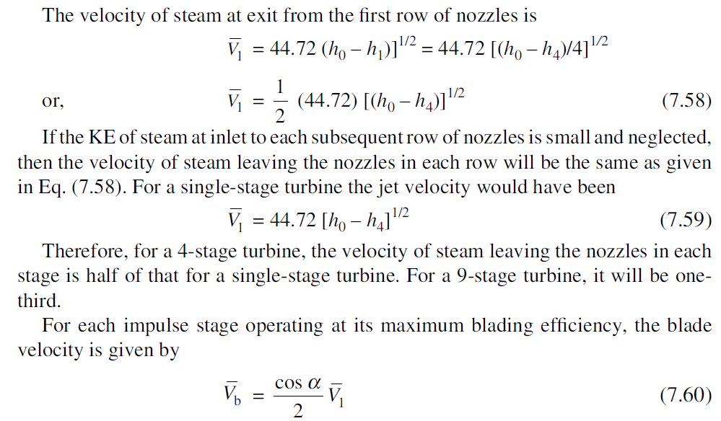

Slide 46
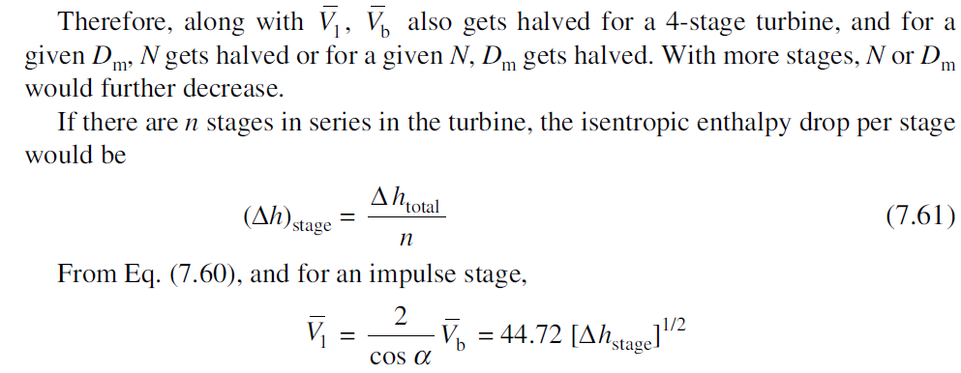
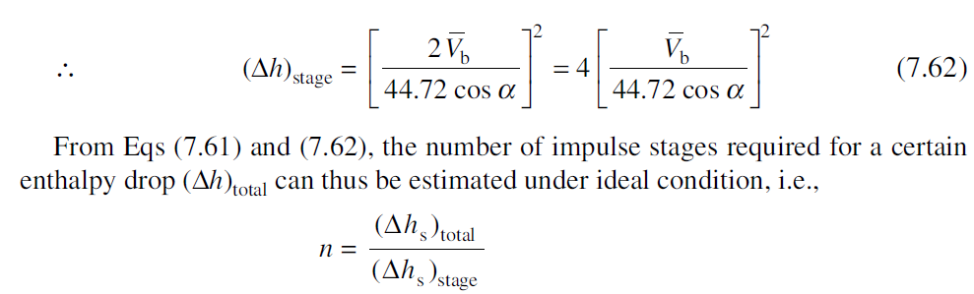

Slide 47

Velocity Compounding or Curtis Staging
In velocity compounding or Curtis staging, all the pressure drop and hence, enthalpy drop of steam take place in a single row of nozzles and the resultant kinetic energy of steam is absorbed by the wheel in a number of rows of moving blades with guide blades in between two such rows.
As shown in Fig. 7.25, steam expands in the single row of nozzles from p0 to p1 with velocity increasing from .
The pressure p1 remains essentially constant thereafter. The KE of steam jets
at nozzle exit is partially converted to shaft work in the first row of moving blades with velocity decreasing from .

Slide 48

The exiting steam jets are then deflected by the stationary guide blades to the next row of moving blades where part of the remaining kinetic energy is converted to shaft work.
It is a two-row Curtis or velocity stage having two rows of moving blades with one row of guide blades in between.
In a three row Curtis stage, the two-row stage is followed by a second row of guide blades and then a third row or moving blades, so that the energy conversion from fluid to rotor takes place in three stages.
Steam with high KE exiting the nozzles works on the first row of moving blades, gets deflected by the first row of guide blades, works on the second row of moving blades, again gets deflected by the second row of guide blades and finally does work on the third row of moving blades.
The velocity diagrams for the first row of moving blades and the second row of moving blades are shown respectively in (a) and (b) of Fig. 7.26.
The blade friction factor kb may be assumed the same for both moving and guide blades.

Slide 49
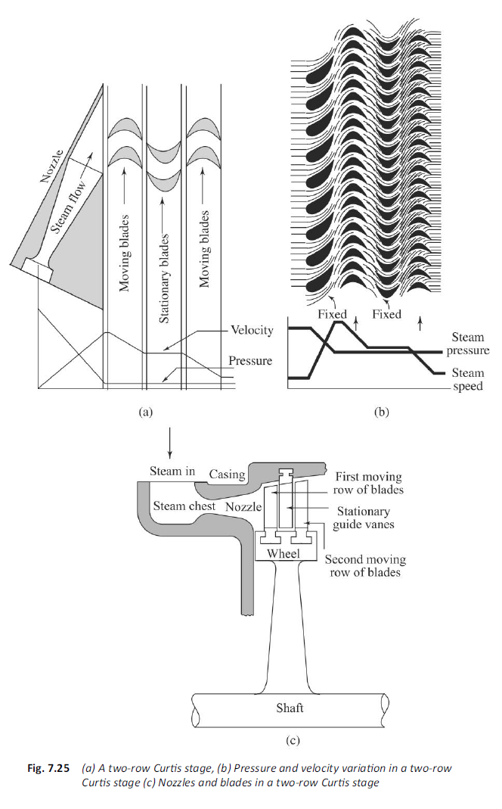

Slide 50
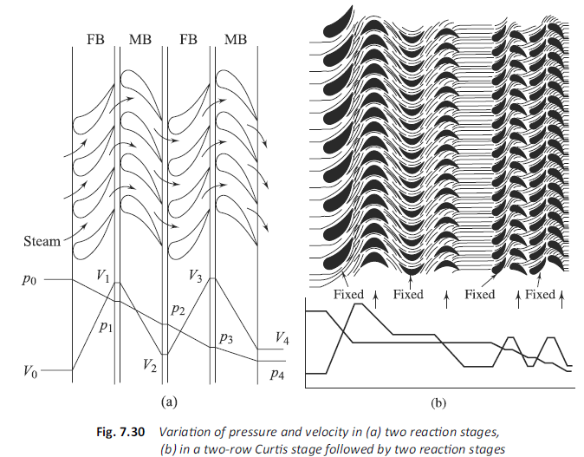
Reaction Turbines

Slide 51
In these turbines, pressure drop occurs both in the nozzles or the fixed row of blades, as well as in the moving row of blades (Fig. 7.30), since the moving blade channels are also of the nozzle shape.
Due to the expansion of steam while flowing through the blades, there is an increase in kinetic energy, which gives rise to reaction in the opposite direction (by Newton’s third law of motion).
Blades rotate due to both the impulse effect of the jets (due to change in their momentum) and the reaction force of the exiting jets impressed on the blades in the opposite direction.
Such turbines are called impulse-reaction turbines, or to distinguish them from impulse turbines, simply reaction turbines.

Slide 52

The degree of reaction (R) of these turbines is defined as
where the subscripts “mb” and “fb” represent moving blades and fixed blades, respectively.
If (Δh)mb = 0, R = 0, which is the case of pure impulse turbines where there is no enthalpy drop of steam in the moving blades, and all the enthalpy drop of the stage take place only in nozzles.
If Δhfb = 0, R = 1, which is the case of a pure reaction (R = 100%) turbine, e.g. Hero’s turbine.
If equal enthalpy drops occur in the fixed and moving blades, i.e. if Δhfb = Δhmb = (Δhstage)/2, R = 1/2 or 50%.
Sometimes, 50% reaction turbines are also called Parsons turbines.

Slide 53
The velocity diagrams for the moving blades of a 50% reaction turbine are shown in Fig. 7.31.
With a simple impulse type the value of Vr2 (= kb Vr1 ) would be given by BE, but in the reaction turbine this velocity is increased to BC by further expansion of the steam in the nozzle-shape blade channels.

Slide 54
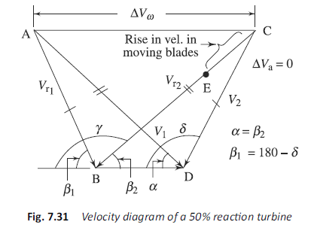
For manufacturing advantage, both fixed blades and moving blades are made similar in shape so that they can be extruded from the same set of dies.
Since Δhfb = Δhmb, V1 =Vr2 again, for similar geometry, α = β2 = 180° – γ
The triangle ABD and DBC are similar.
Vr1 = V2 and β1 = 180° – δ

Slide 55
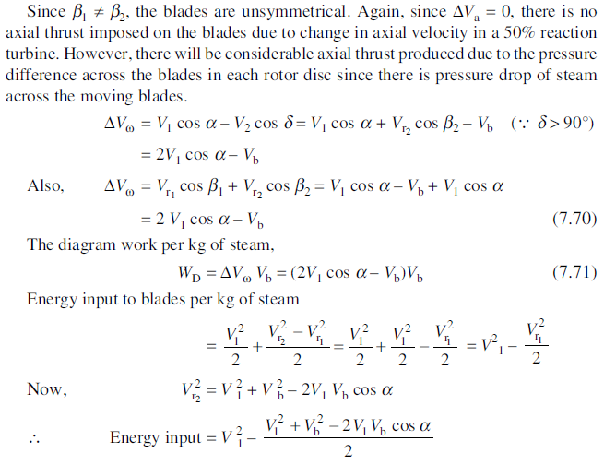

Slide 56
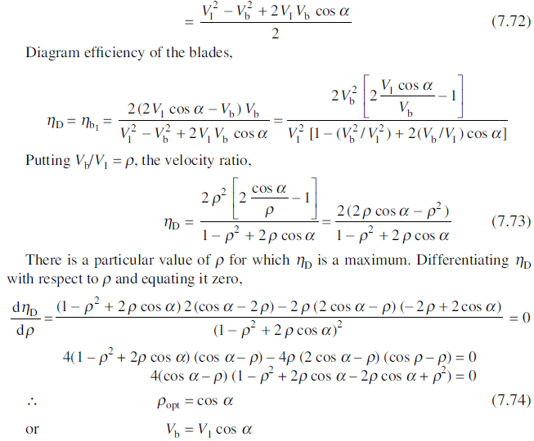


Slide 57
P1. The velocity of steam entering a simple impulse turbine is 1000 m/s, and the nozzle angle is 20°. The mean peripheral velocity of blades is 400 m/s and the blades are symmetrical. If the steam is to enter the blades without shock, what will be the blade angles?
(a) Neglecting the friction effects on the blades, calculate the tangential force on the blades and the diagram power for a mass flow of 0.75 kg/s. Estimate also the axial thrust and diagram efficiency.
(b) If the relative velocity at exit is reduced by friction to 80% of that at inlet, estimate the axial thrust, diagram power and diagram efficiency.

Slide 58
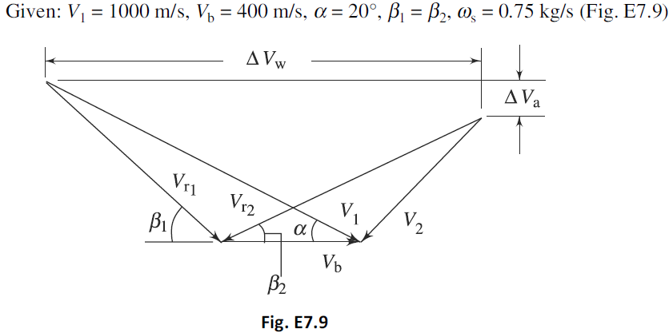

Slide 59
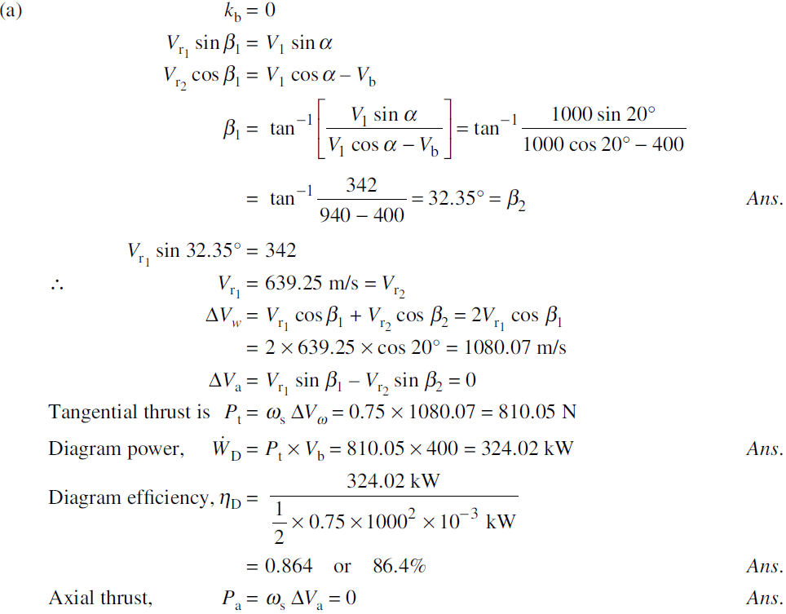

Slide 60
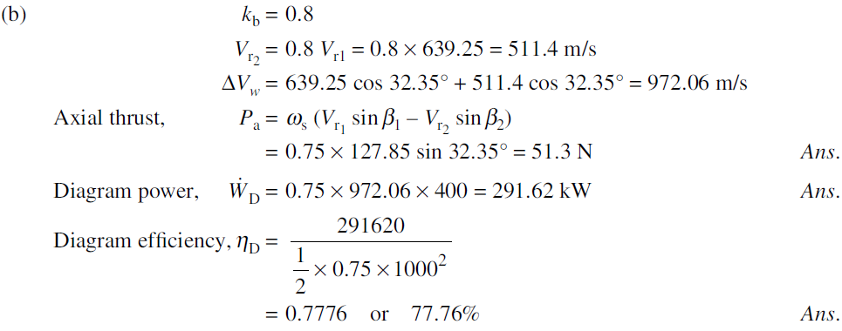

Slide 61
P2. The angles at inlet and discharge of the blading of a 50% reaction turbine are 35° and 20°, respectively. The speed of rotation is 1500 rpm and at a particular stage, the mean ring diameter is 0.67 m and the steam condition is at 1.5 bar, 0.96 dry. Estimate
(a) the required height of blading to pass 3.6 kg/s of steam, and
(b) the power developed by the ring.

Slide 62
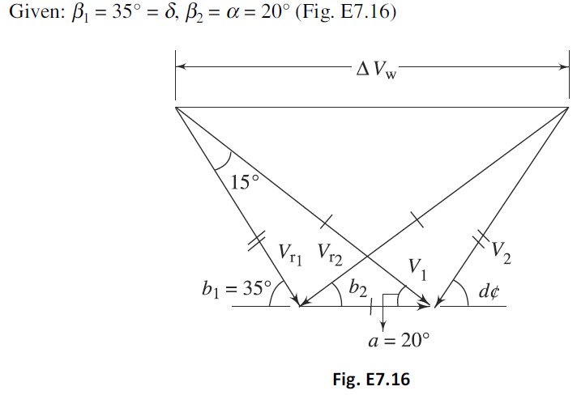

Slide 63
